Slide 1
Visualizing Communication
Nina Sobell©2010

Slide 2
Introduction
My goal in developing interactive environments, whether sculptural or high tech is to provide the stage and the props to enable people to rediscover their capacity to play.
It is through play, I believe that we evolve as individuals and as a culture, and through play we learn to feel we have control over some small part of our surroundings.

Slide 3
I experiment with….
the place between thought and experience
the locus of perception and memory
visualizing the energy of communication
the edge of experience, thinking of an idea, executing that idea and then observing it

Slide 4
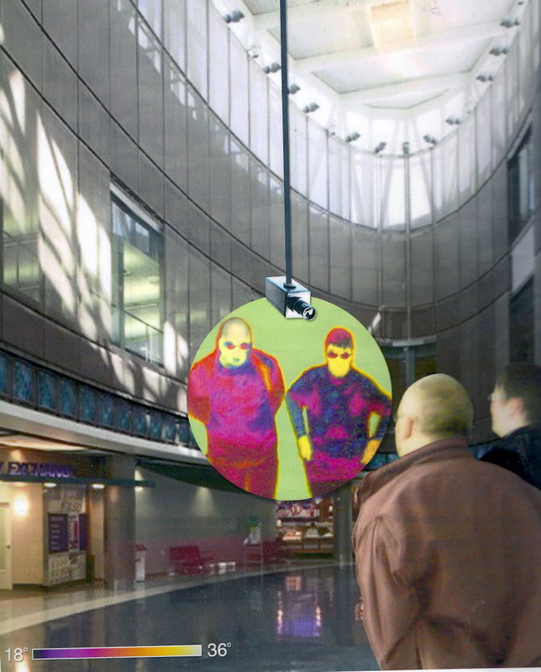
Thinkies TM
Thinkies is an interactive Infrared camera imaging system for airports; consisting of a revolving Infrared camera, globe, and rear projector.
The camera revolves around the globe capturing peoples’ temperature changes
The rear screen projector revolves simultaneously

Slide 5
New York / Prague
Skype Performance Transmissions
Transmissions was a Skype performance between Prague and New York
Using Skype to transmit information between New York City and Prague, I received instructions from the participants of TINA B. Prague Contemporary Arts Festival at the Vernon Gallery, to create clay sculptures in my NYC studio. The participants in turn used this information to create drawings of the sculpture in real time, illustrating how virtual, two, and three-dimensional time can coexist.

Slide 6
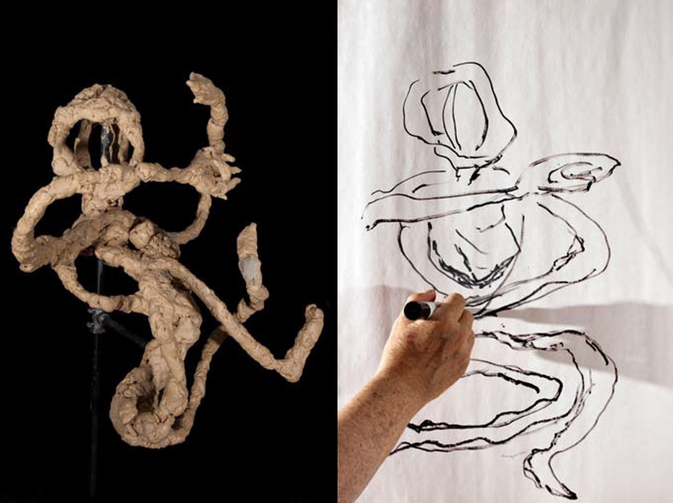
New York / Prague
Notes:
I am in New York receiving information on what to do on the sculpture.

Slide 7
New York / Prague Transmissions
The sculpture became
a mediation between my execution and their direction, and
a true collaboration that could only take place using real-time
technology. Three-dimensional sculptural space, virtual Skype
space and two-dimensional drawing space co-existed to create
a collaborative work in which sculpture was the source of the
drawing and the drawings the inspiration for new sculptures, a
work of extreme tactile interactivity.

Slide 8
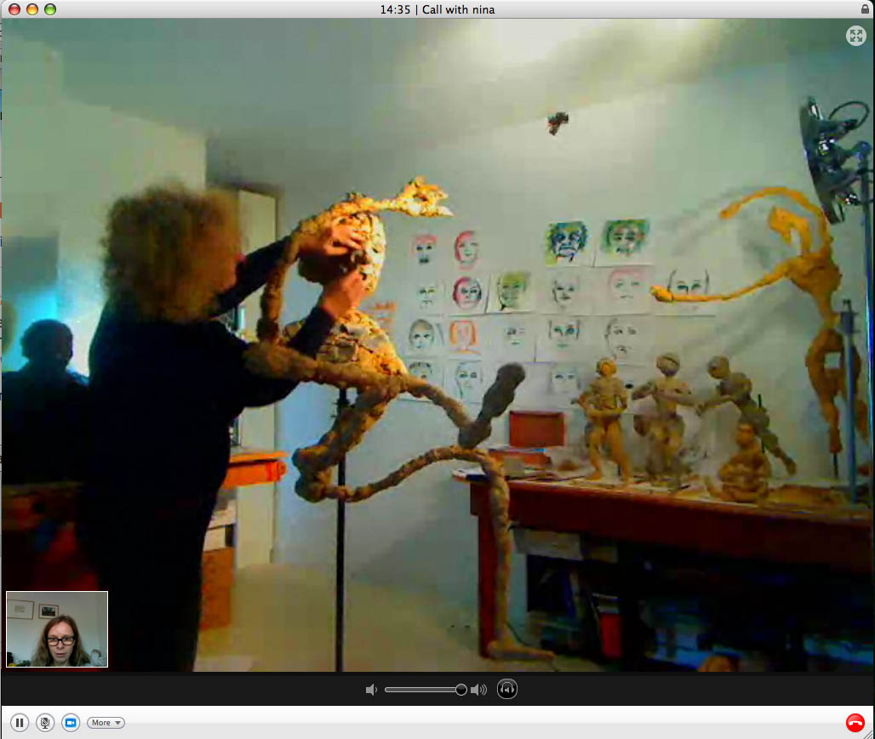
New York

Slide 9
Brainwave Drawings
2008
Documentary of the re-creation of the original Brainwave Drawing Installation
of 1974
at the
Getty Museum in
Los Angeles, California 2008

Slide 10
Thinking of You 2004
Part of the show
Synaesthesia,
curated by Chloe Vaitsou
at the Institute of Contemporary Art,
in which I collaborated with
Miguel Andres-Clavera

Slide 11
A short history of early
Brainwave Drawings 1973 - 1982
The following is a short history of early
Brain wave Drawings 1973 - 1982

Slide 12
Introduction to ParkBench
I have experimented with the Web to discover its potential for creative, collaborative expression, and to explore and sculpt the boundaries between physical space and cyberspace. My work has grown directly out of my interactive video installations of the early 1970's, in which I used the medium to sculpt space and time, and to create bridges for shared human experience. My inspiration, in the collective ParkBench, has been to address the physical disconnectedness of the information age by creating a safe place to congregate in cyberspace. My work has inspired the development of new technologies, including a wireless telerobotic video camera for streaming video to the Web from remote locations.

Slide 13
Web Seance
From October to December of 1998, ParkBench (Sobell, Hartzell, Jesse Gilbert & Sonya Allin) were in residence at Banff Centre for the Arts, where we created an installation/event called Connecting the Dots. This piece explored the space between thought and experience in a live web performance in which two people's brainwave communication was mediated by images and sounds.
Web Seance: Brainwave Drawing, an installation at the Walter Phillips Gallery, Banff Center for the Arts extended this piece by using the Web to join two performers, and by creating a virtual circle whereby the Web audience adds their attention to the piece.

Slide 14
Web Seance
The medium is the Medium
In this seance, a Web-based, artificially intelligent "chatterbot" leads the seance. The Web site gives the audience a place on the Web to "join hands," keeps track of those present, and lets them know who else is there with them. The ChatterBot Medium answered questions. As each person logged on, their IP address was visible, they became a yellow dot; the more dots the larger the yellow glow grew, as the séance became a collective memory.
The medium is the Medium
Notes:
Go to website

Slide 15
Web Seance
Without Words
Anecdotes about participants' experiences with nonverbal communication were entered; after three new entries, a shareware program called dadadodo (www.jwz.com/dadadodo) disassembled the stories into parts of speech and assembled new sentences from those words. 90 retrievable stories were contributed during the course of the performance. Without words…

Slide 16
Web Seance
Memories, Dreams, and Fantasies
The Medium poses a series of meditations to two EEG artists, one in Banff and one in New York. We watch their eyes and brainwaves, and listen to their heartbeats, as they ponder each one. Then they, and we, write about the memory, dream or fantasy we've just inhabited. An artist in Banff transcribes their words into drawings on paper.
Our stories fill a database, from which a voice reads during the performance, mixing with heartbeats

Slide 17
Weaving Sun and Moon
A Synchronous EEG Seance Performance
One Hour Before the Total Eclipse August 11, 1999
between two locations: Chateau de Sacy, Sacy le-Petit, France
and the Arts Catalyst boats, Channel Islands
For one hour before the eclipse of the sun at the Chateau de Sacy, I and musician Anders Mansson, connected by an electro-encephalograph (EEG) displaying the synchronicity of their brain waves, made one-minute drawings every five minutes.
This web seance occurred simultaneously with artist Anne Bean, and participants on the Art Catalyst boats in the English Channel, as we concentrated on thoughts of each other and the impending drama as it drew near.
This project was an attempt to join physically distant people in a celebration of shared collective experience using the Internet as a global nervous system. About 85 participants at each site were present to witness this event of non-verbal communication. Weaving Sun and Moon

Slide 18
ParkBench 1994 -1999
In 1993, I conceived of ParkBench, a network of kiosks, which through videoconferencing, internet access, and a collaborative drawing space, would enable people in diverse neighborhoods to access the internet, talk to and see one another, and communicate collaboratively and creatively. I and collaborator Emily Hartzell were invited be artists in residence at New York University's Center for Advanced Technology in order to develop ParkBench. Since this was before the Web's emergence, we used Director to design the ParkBench interface, which was the first such graphical interface to New York. Later in 1994, after the Mosaic browser introduced a graphical interface for the internet, we adapted our interface, making it the first of its kind on the World Wide Web.

Slide 19
ArTisTheater
At NYU CAT, in 1994, we used one of the Web's first remotely-controlled cameras to transform our studio into a time-based public Web installation in order to research the nature of Web video as a medium. The Web gave visitors 24-hour real-time access, through the eye of the camera, to watch us work, so at times our actions were heightened by our awareness of unseen Web visitors. At other times we felt ourselves dissolved in the ubiquitous surveillance which now erases the boundaries between private and public. In 1994 we launched the Web's first live performance series, ArTisTheater, whose archive of non-narrative, improvisational, dadaesque works now contains over 80 performances (including works by guest artists.) The performances reflect the evolvement of technology from the first telerobotic B/W pinhole camera to experimental color, true color and sound .
ArTisTheater

Slide 20
VirtuAlice 1994 - 1997
We created VirtuAlice in 1995, in collaboration with engineers at New York University Center for Advanced Technology, for the CODE exhibition at Ricco Maresca Gallery in New York. Alice is a wireless, mobile, content-collection vehicle for the Web. Alice's eye (a telerobotic camera), uploads video stills to the Web, where Web participants control the camera's direction. People on the street could touch pads through the window and also control Alice’s eye.
VirtuAlice consists of Alice's wheeled throne, a monitor inside the gallery and a monitor in the front window. Visitors drive around the gallery, and the direction of a telerobotic camera mounted on the throne is controlled by participants over the Web or by touching pads in the front window. A monitor on the throne's handlebars shows the driver the direction of the Web visitor's or person on the sidewalks interest; the throne's driver acts as chauffeur for the Web or sidewalk visitor.
Her memories, the archive of what she's seen in a day, represent a subjectivity negotiated by participants in three spaces: interior, exterior, and Webterior or Webspace.
VirtuAlice is a vehicle for a shared experience, whereby participants collaborate in transferring that experience into meaning, into history. By appropriating surveillance technology and interweaving surveillance streams, she raises questions about subjectivity and control. VirtuAlice is an expression of the process which is the world we live in--physically out-of-control, yet remotely controlled.

Slide 21
Right Brain / Left Brain
Investigation into the Creative Process
When might my Right Brain dominate my Left?
I experimented to see when I would no longer be able to speak because I needed to concentrate on what I was doing.
I kept talking constantly until concentration on details finally inhibited my speech completely.

Slide 22
Six Converging Cameras /
Three Converging Views
New York and Los Angeles, 1981-2 In a storefront window is built a rack supporting three tiers of monitors and three pairs of cameras. The cameras are mounted on oscillators, which cause them to pan the street outside the window in 180 degree sweeps. The monitors' screens are split, so each half represents the input of one camera. The cameras mounted on the bottom tier pan the sidewalk: the right camera scans from far right to center a back again, while the left camera sweeps from far left to center and back. The images converge at the center, where pedestrians' feet are engulfed by the sidewalk. The middle tier represents the level of the storefronts on the opposite side of the street, and the top tier shows the sweep from earth to skyscrapers' tops to earth to sky. Inside the gallery, one monitor with a six-way split represented the amalgamation of all six views.
The piece was installed at Franklin Furnace, New York, and at LACE in LA and the Otis Art Institute.

Slide 23
Nina Sobell: Pioneer in Interactivity
This is a documentary made by
1993©Emily Hartzell

Slide 24
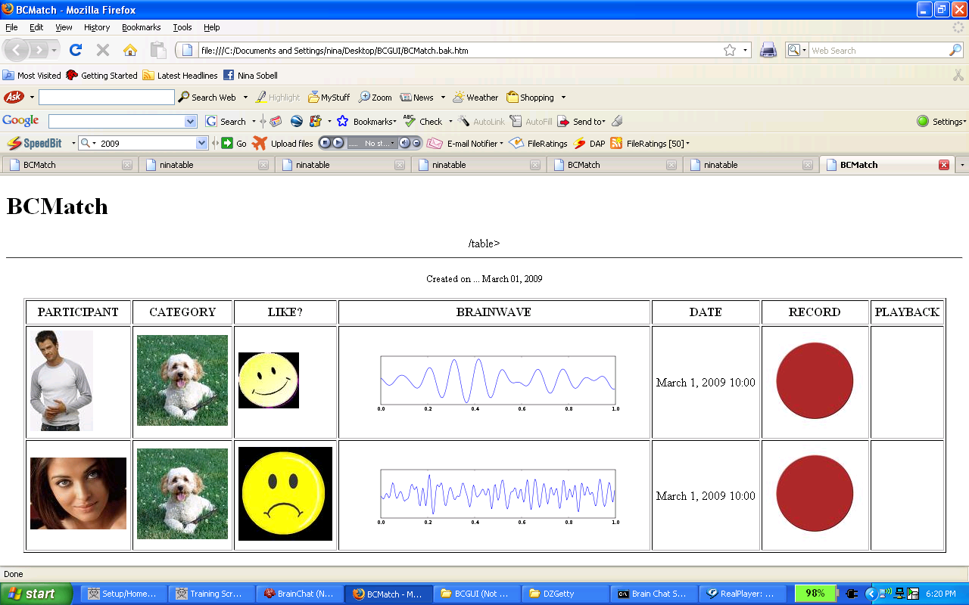
BrainChat TM Patent Pending

Slide 25
BrainChat TM patent pending
This is an example of the BrainChat Match application
It shows two people, one male, one female who have chosen a dog from the categories column
It shows that the male says he likes the dog, but the female she doesn’t by electing a smiling or frowning icon.
The brain wave output reflects this disparagement
Record date, record mode and playback mode are available

Slide 26
BrainChat TM patent pending
BrainChat networks two or more participants at separate physical locations by transmitting and interpreting brain wave patterns and other physiological factors of each participant
The commercial application of BrainChat utilizes interactive brainwave visual analysis as a means to explore various aspects of human interaction.

Slide 27
BrainChat TM patent pending
This is highly portable neurofeedback technology. The broad applicability of this versatile communication interface software provides an ideal platform for the direct commercial application to both the on-line dating and personal gaming markets, interactive educational exhibits, security and medical applications.

Slide 28
BrainChat TM patent pending
"BrainChat“ is an evolution in biocommunication interface technology
"BrainChat" is proprietary brain-imaging technology that remotely biosenses the brain wave patterns of two or more participants that are communicating with each other and translates back - in real-time - the convergence of these patterns using universal graphical and audio displays

